Slide 1

CarterRewards
by Carter Banking
Voucher Redemption App
MERN Stack

Slide 2



Introduction
CarterBank is a premier financial institution in Malaysia, renowned for its comprehensive banking services and customer-centric approach.
In line with its commitment to rewarding customer loyalty and enhancing digital banking experiences, CarterBank proudly introduces CarterRewards — a cutting-edge mobile application designed to empower users with exclusive benefits, seamless reward redemptions, and personalized financial insights.
CarterRewards is more than just a loyalty platform; it’s a smart companion for CarterBank customers, bridging convenience, value, and trust in one intuitive app. Whether you're shopping, saving, or spending, CarterRewards ensures every transaction brings you closer to greater rewards and smarter financial habits.
CarterRewards
01
by Carter Banking

Slide 3

Objective
The objective of the CarterRewards app is to strengthen CarterBank’s customer retention and market position by delivering a comprehensive, mobile-responsive loyalty platform. Through a point-based reward system integrated with attractive and competitive offers, the app aims to:
Objective 1
Objective 2
Objective 3
Drive higher customer engagement through personalized and rewarding interactions
Foster stronger brand loyalty by providing value-added experiences that differentiate CarterBank from its competitors
Enhance user retention by incentivizing continued banking activities
CarterRewards
02
by Carter Banking

Slide 4
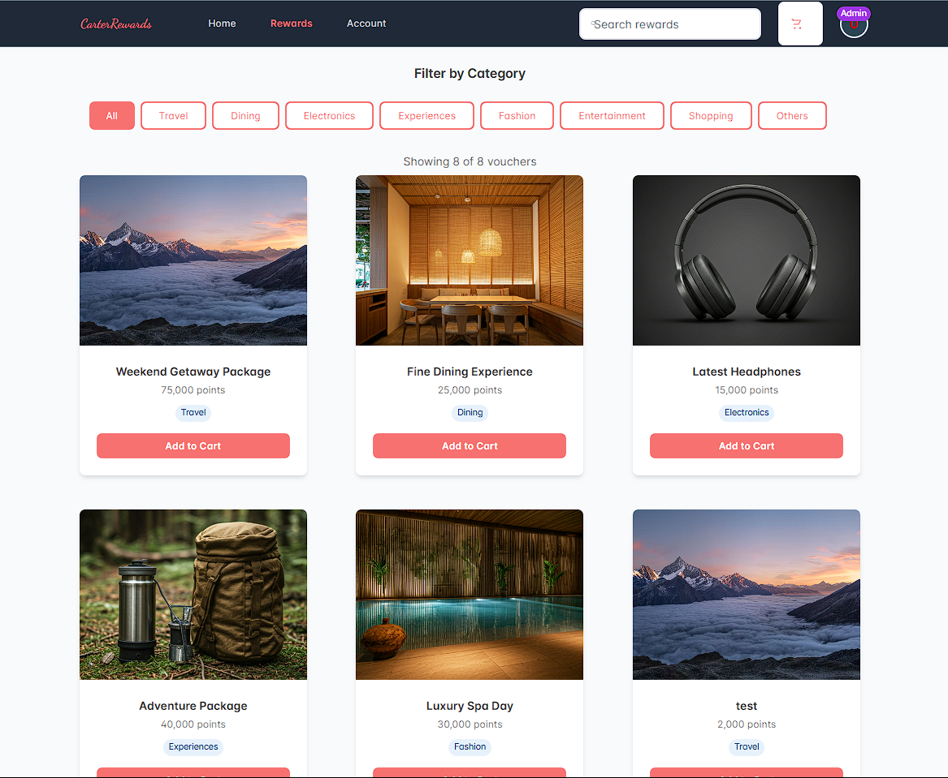
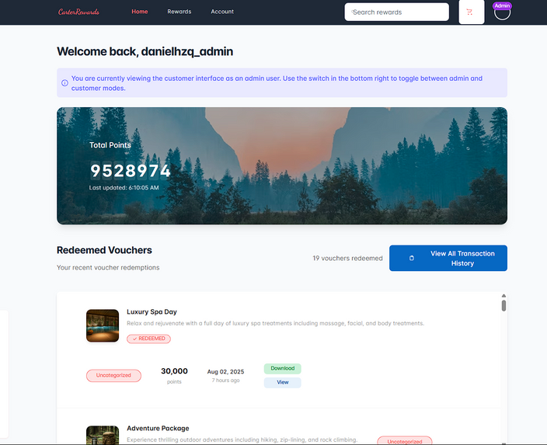

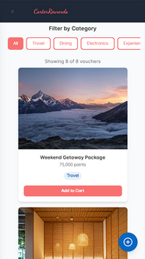
Solution
A loyalty platform, allowing users to accumulate points through their banking activities, strategic tool designed to deliver an easy, seamless, and rewarding customer experience.
By combining simplicity, speed, and interactivity, the app makes the process of earning and redeeming rewards straightforward — eliminating friction and enhancing user experience
04
CarterRewards
by Carter Banking

Slide 5

Presentations are communication tools that can be used as demonstrations, lectures, speeches, reports, and more. It is mostly presented before an audience.
KEY FEATURES
1. Authentication
2. Interactive Home Page
3. Voucher Attributes
Secure user registration and login system using JWT (JSON Web Tokens), ensuring only authorized users can access and redeem rewards.
Interactive, mobile responsive and easy-to-use interface. Allowing seamless and attractive customer-app interactions.
Each voucher includes detailed information such as brand, value, expiry date, redemption conditions, and required points—ensuring transparency and easy decision-making.
4. Shopping Cart
5. Integrated AI Chat
6. Admin Console
Users can add, manage, and redeem multiple vouchers in a streamlined cart system before final checkout—mirroring a familiar e-commerce experience.
A built-in AI chatbot offers real-time support, answers user queries about the app, and guides users through voucher redemption or account issues.
A secure backend interface for administrators to manage users, vouchers, redemptions, analytics, and content updates—ensuring smooth platform operations.
CarterRewards
05
by Carter Banking

Slide 6
FRONT END TECHNOLOGY
CarterRewards
by Carter Banking
Tools | Roles | Purpose
React.js | Framework | JavaScript library for building user interfaces, handling component-based architecture, state management, and creating interactive UI elements for the voucher redemption system.
Tailwind CSS | Styling | Provides fast, consistent, and responsive UI styling directly in JSX. Used throughout the app for responsive design, mobile-first approach, and the CarterRewards theme implementation with custom CSS variables.
PrimeReact | Components | Prebuilt, accessible UI components like buttons, modals, cards, data tables, and form elements—customizable to match the CarterRewards design needs and brand colors.
JSPDF & QRCode | Utilities | Generates PDF vouchers with QR codes for redeemed rewards, providing downloadable proof of purchase for customers.

Slide 7
BACK END TECHNOLOGY
CarterRewards
by Carter Banking
Tools | Roles | Purpose
Node.js | Runtime Environment | JavaScript runtime that executes server-side code, handles HTTP requests, and manages the backend application lifecycle for the voucher redemption system.
Feathers.js | Framework | Real-time API framework that provides RESTful services, WebSocket support, and service-oriented architecture for building scalable backend applications with built-in authentication and database integration.
Express.js | Web Framework | Handles HTTP requests, middleware processing, routing, and provides the foundation for building RESTful APIs and web applications with robust error handling and security features.
MongoDB & Mongoose | Database | NoSQL database for storing voucher data, user information, and transaction records, with Mongoose providing schema validation, middleware, and object modeling for MongoDB.
Ollama AI Engine | Local AI Engine | Runs large language models locally on the server, providing AI chat capabilities without external API dependencies. Supports models like qwen3:0.6b, llama2, and mistral for generating intelligent responses to user queries.

Slide 8
DEMONSTRATION
CarterRewards
by Carter Banking

